Slide 1
Info @IT Helpdesk

Slide 2
Introduction Presentation
This system is used by the Info@IT department to record all the tasks that they are responsible for, e.g. lab maintenance, upgrades to labs, equipment that needs to be replaced, student requests.
The lab manager uses this system to maintain staff and interns.
To schedule lab inspection
Receive new equipment and assign them to venues.
The manager assign an intern to attend student requests.
Interns uses this system to check the tasks that they are assigned to do.
To record all the faulty equipment in the labs.
To create and print their reports for all the tasks they were assigned to do.

Slide 3
Project Content
ERD Process
Use Case
Login Process
Project Controls Functionalities
Add, Update, Soft Delete, Delete.
Project Error Handling
Discard From Adding Empty text,
Discard From Adding Existing Data
Project Description Reports
Equipment
Total number of equipment
Equipment that is broken
Equipment that is in for repairs
Inspection
Number of inspections between dates
Inspections for a staff member
Inspections in a single lab, in a month.
Requests
Request by task type.
Staff responsible for a request
Request for a month
Requests that end up at ICT Help Desk
Tutor Requests
Tutor requests by module
Tutor requests in a venue
Tutor requests in a month

Slide 4
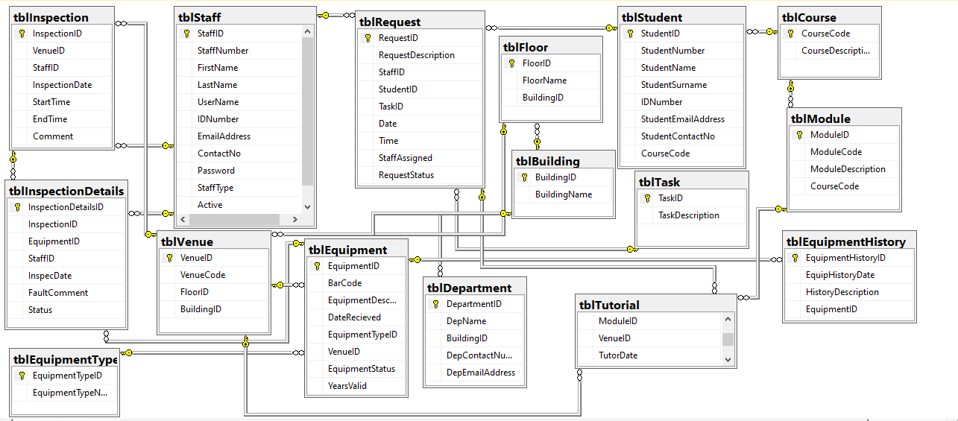
ERD

Slide 5
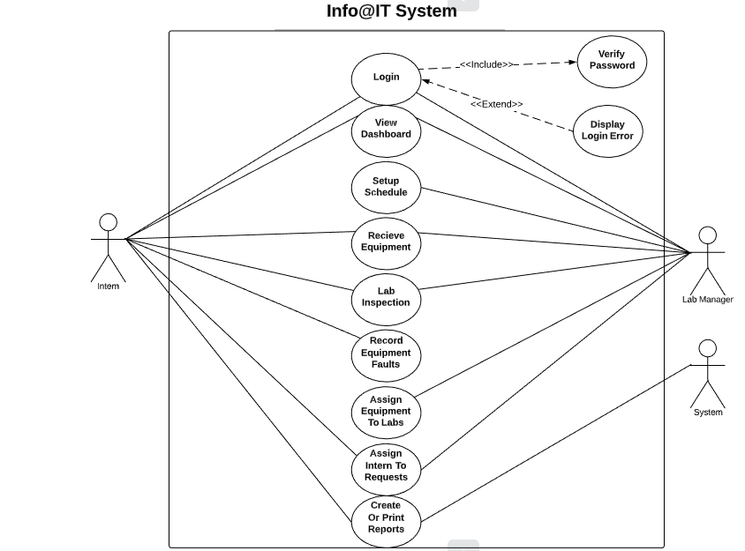

Slide 6
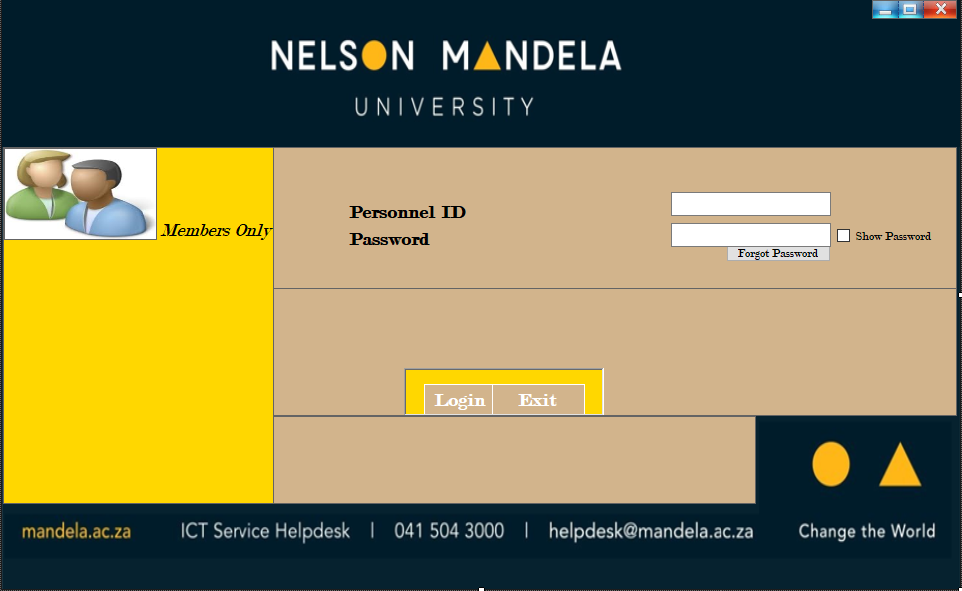
Login Process
We have two people that are able to login in this system that’s intern, and lab manager.
The password for LAB MANAGER is Password
And the password for INTERN is Password
NB All case sensitive
We make use of authentication whereby you have to click on “Forgot Password” if you are registered by forgotten the password.
Forgot password button would take you through to a small form where you will have to fill your user name and ID Number
Then if your username and ID Number matches then it will send back your password to a messagebox

Slide 7
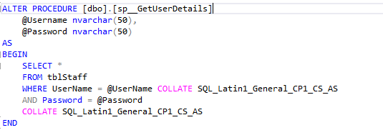
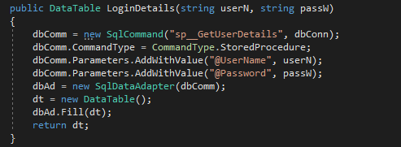
Continues….. Login Process
Store procedure
DATA ACCESS LAYER CODE

Slide 8


Continues….. Login Process
Business logic layer
Presentation layer code

Slide 9
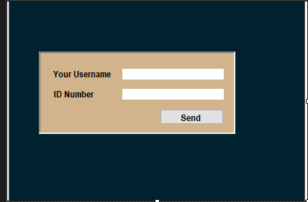
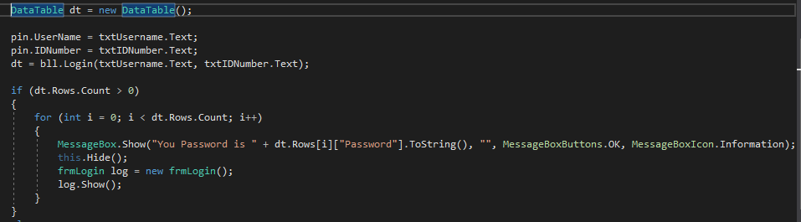
Continues….. Login Process
Forgot password Form
Forgot password code

Slide 10
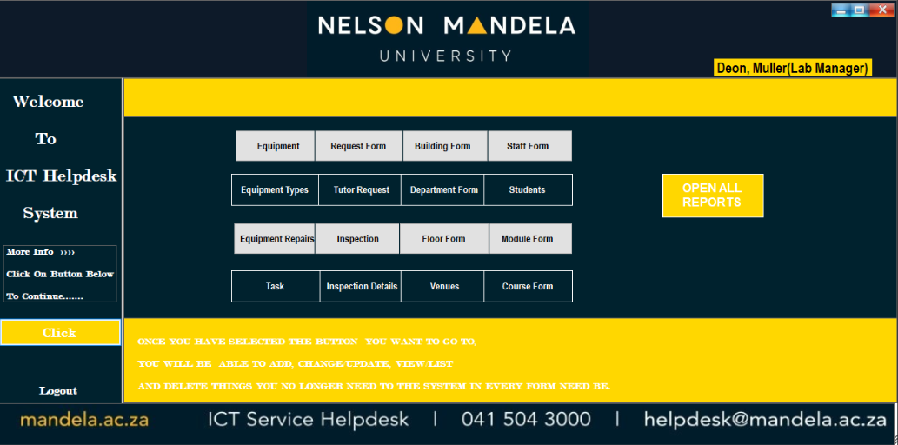
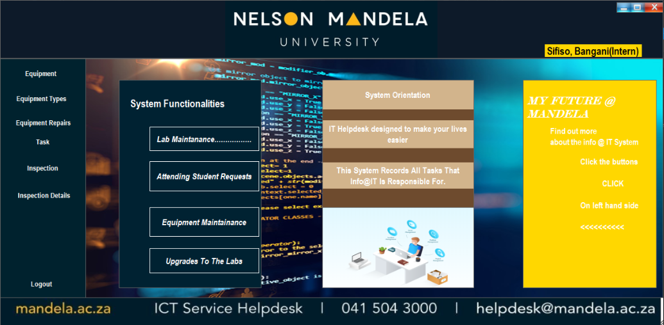
Project Controls Functionalities
In our system presentation form we using parent form of which we using it as our dashboard, and child forms.
Our dashboard are two different type depending on who logon to the system, if a person logged in to the system is manager it’d display their name and title and its send that person to a right dashboard.
There are things that an intern is not supposed to see or do like registering staff. So for that interns they are somehow limited to a system overall.

Slide 11
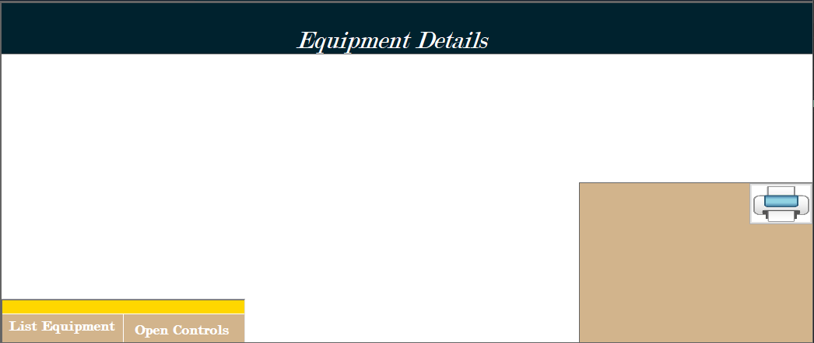

Control Instruction
We have buttons that we use to manage our system.
At first whenever you run the system most controls are visible false or invisible, so you need to press relevant button to make them visible.
There’s a so called “Open Controls” button in every form, which used to make some form control visible or bring to front so as a user can be able to do whatever their want to do, like add data, update, delete.
The other button is “List …” whereby used to list data and/or bring front the datagridview.
If you look at the Equipment Form on the left its blank with just three button controls of which it’s a “List Equipment” and “Open Controls, and of course on the left there’s a picture button for printing.
So the two left down buttons are the one you should use to bring upfront the other controls.

Slide 12
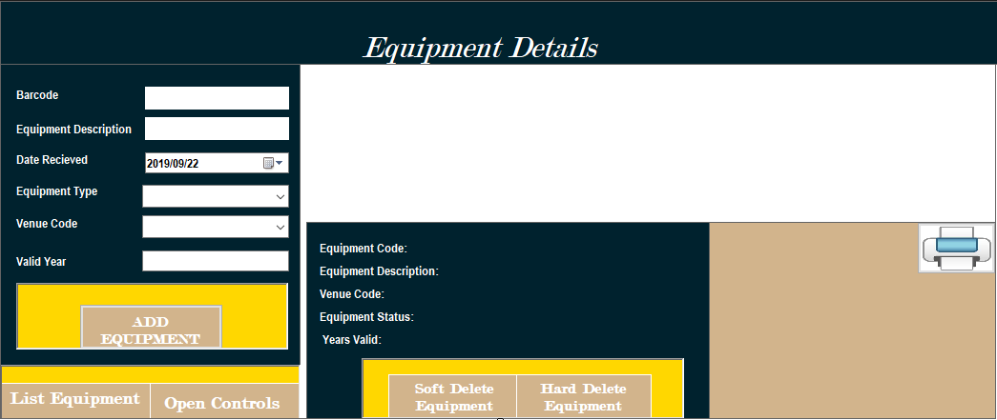
An actual form after all controls has been brought in front

Slide 13
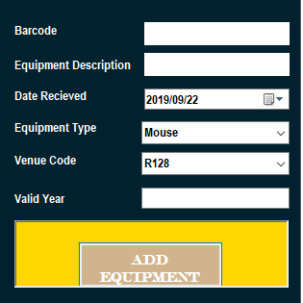
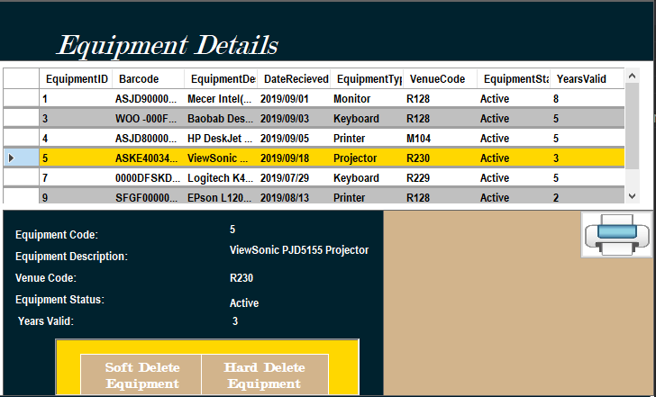
We will show two different forms and explain their functionalities.
First one is Equipment already appeared on a slide above.
We believe equipment we talking about here are the ones in our labs, of which in an add button a lab manager or intern can add the equipment to a system lets say that equipment is from vendors and assign them to a lab, of course intern can do that under supervision of a manager.
We have an ADD button to add equipment on a system and SOFT DELETE button is used to change their status to “IN-ACTIVE” as we believe when the equipment arrived from store is active because is being tested and confirmed is working.
As an equipment being used there are circumstances leads an equipment to stop working as it was or just broken in such an extend that there’d be no use for it. So at the time is not work but it still on a lab that’s when we change their status to “IN-ACTIVE”.
HARD DELETE its when there be no used for it, its broken none repairable and being removed from the lab and that’s when we delete or remove it at the database.

Slide 14
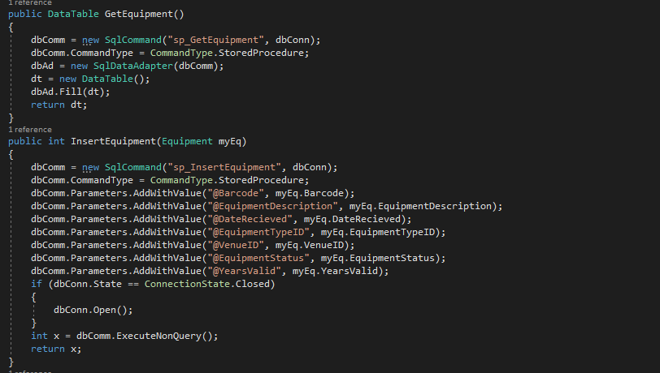
Database, store procedures and code related to equipment presentation
ADDING DATA BY add button
DAL FOR GET AND INSERT
Data access layer code,
Business logic layer,
Presentation layer code,
Store procedures

Slide 15
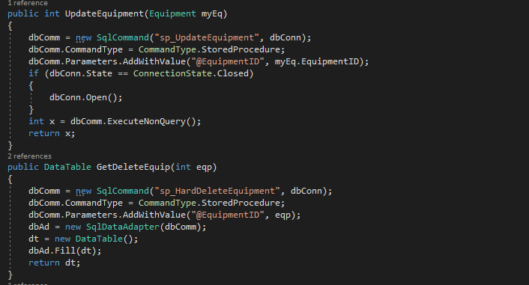
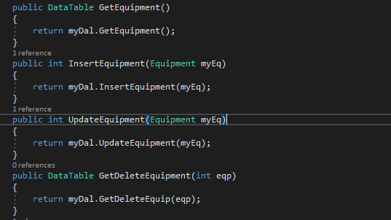
CONTINUEs……
DAL FOR UPDATE / SOFT DELETE AND HARD DELETE
BUSINESS LOGIC LAYER

Slide 16
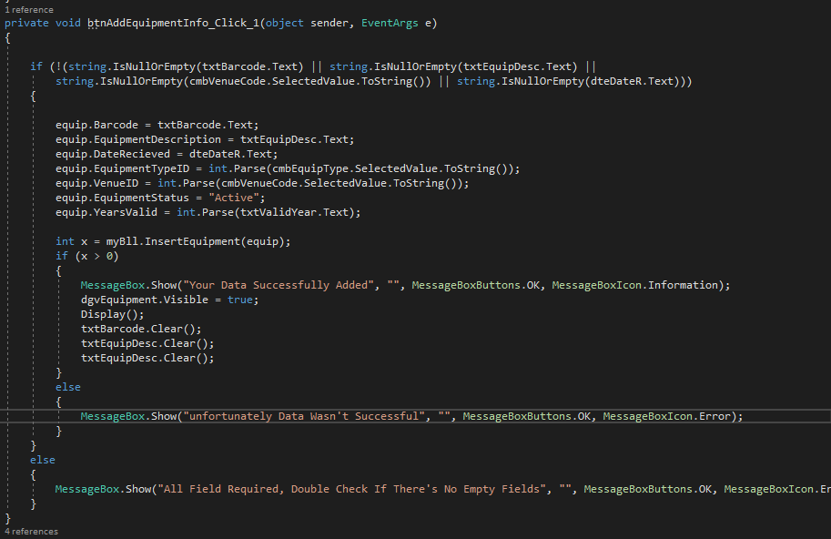
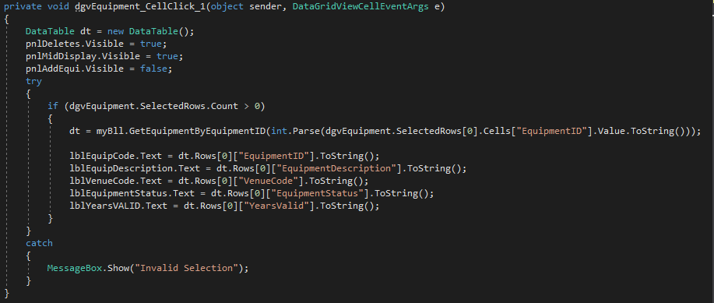
CONTINUEs…..
Form presentation code for get and inserting
Form presentation for Cell click to display on labels

Slide 17
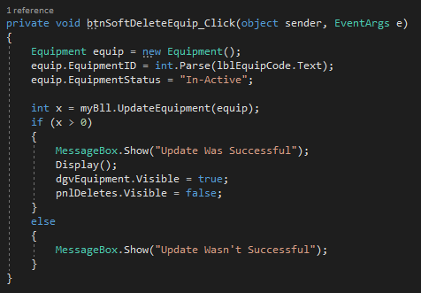
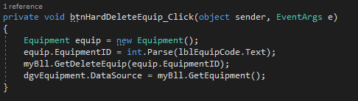
Continues….
FORM PRESENTATION CODE FOR UPDATE OR SOFT DELETE
FORM PRESENTATION CODE FOR HARD DELETE

Slide 18
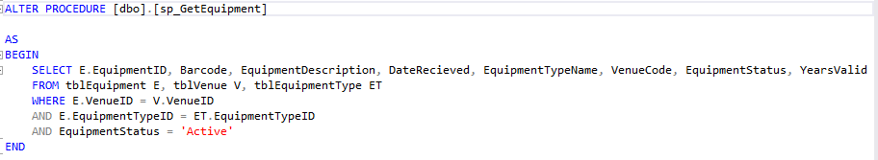
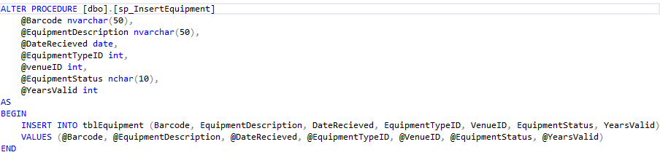
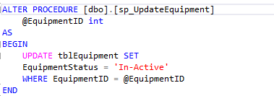
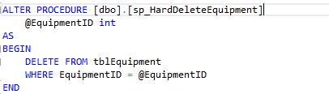
Continues …. Store procedures for equipment table
Store procedures

Slide 19
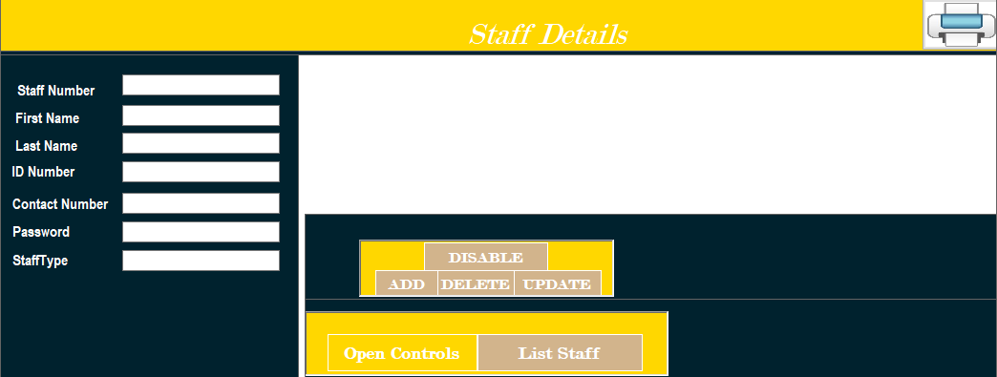
OTHER PRESENTATION EXAMPLE FOR SYSTEM FUNTIONALITIES IS “STAFF”

Slide 20
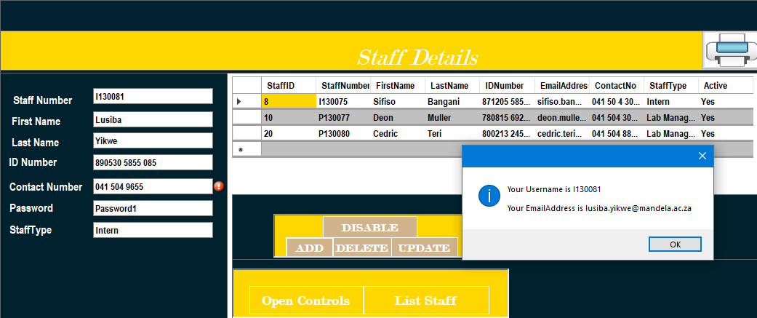
Continues…… Staff
In this form we don’t actual insert every details but our system at some time , somewhere it auto fill other details while a manager is registering some staff member like interns on a system.
In an insert or add the status, username, email address a manager doesn’t insert physically but our system provides it with a message box after adding that person.
These control are invisible when you fill on it but when you want to update information about a person they become visible but enable to false.
In this form you can add, change/update, delete, and disable or de-active a person if that person is not active any more.
We believe interns don’t stay as interns forever. if an intern is not active maybe has some other duties than being a lab inspector or student assistant. They become junior lecturers and so for that as their record of whatever they’ve done are still existing, so that intern can not be necessarily be deleted on a system but disabled or de-activated as an intern.

Slide 21
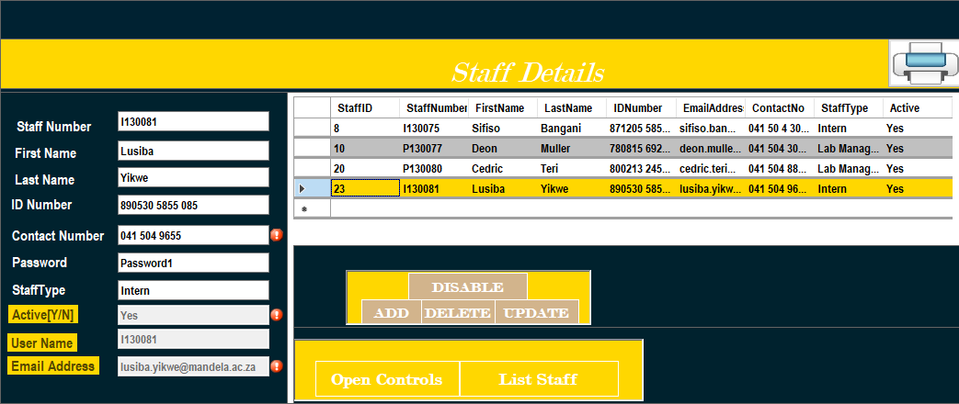
Continues…… Staff
After pressing disable button become a staff member that is being selected disappear and their status become NO. See example below,

Slide 22
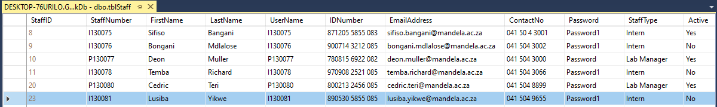
Continues…… Staff
Other function works normal which is Updating and Delete.
A staff that was disabled is now status change to not active

Slide 23
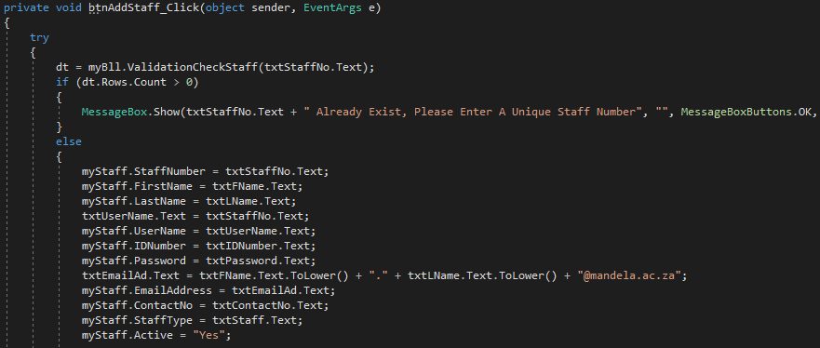
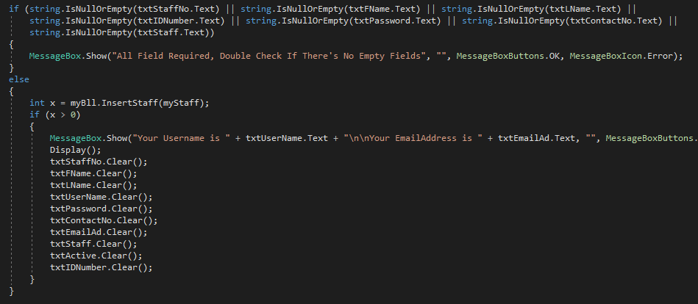
store procedures and code related to Staff presentation regarding auto adding
Code regarding auto adding

Slide 24
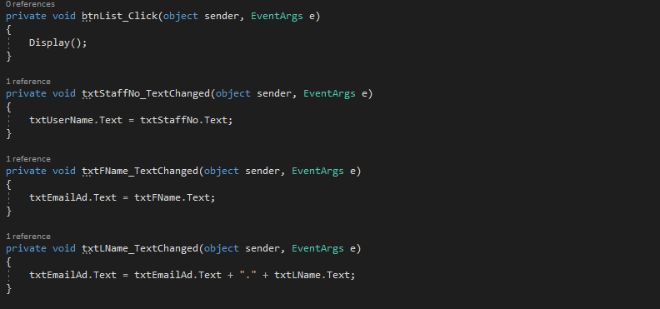
Continues…… Staff

Slide 25
Error Handling

Slide 26
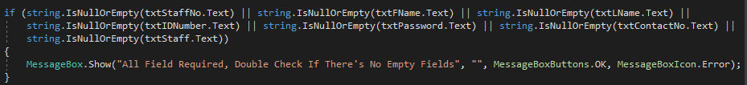
Control validation
We have code that handle not to add empty in data grid view.
It check if a textbox is empty and gives and error message if there’s no data in it.

Slide 27
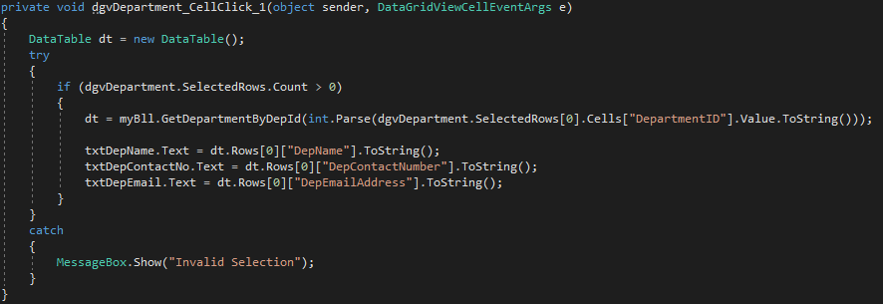
Datagrid view
This is a code of try and catch, it handle error to occurs if maybe you click on and part of datagrid view without noticing.
Whenever you click on the datagrid view by mistake it will not crash but it’d only give and error message.

Slide 28
Data Execution check
This code checks if there’s no redundance of data in the database.
You make a store procedure that check that parameter.
Data access layer code,
Business logic layer code,
And Presentation layer code.

Slide 29
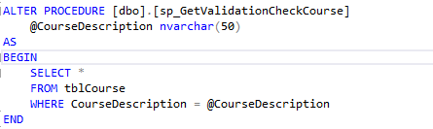
Continues…. Error handling
Data Execution check
STORE PROCEDURE
This code checks if there’s no redundance of data in the database.
You make a store procedure that check that parameter.
Data access layer code,
Business logic layer code,
And Presentation layer code.

Slide 30
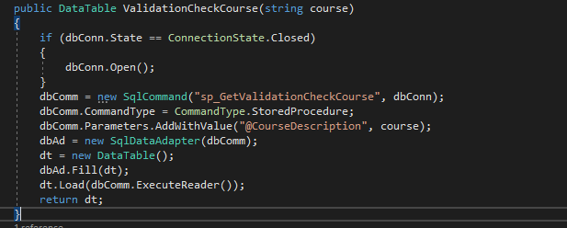

Continues…. Error handling
DATA ACCESS LAYER CODE
Business Logic layer

Slide 31
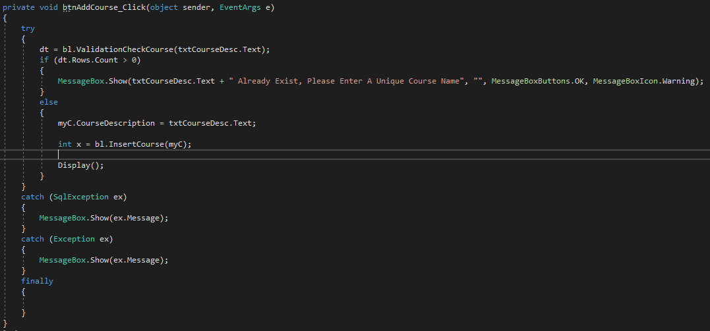
Continues…. Error handling
Presentation code

Slide 32
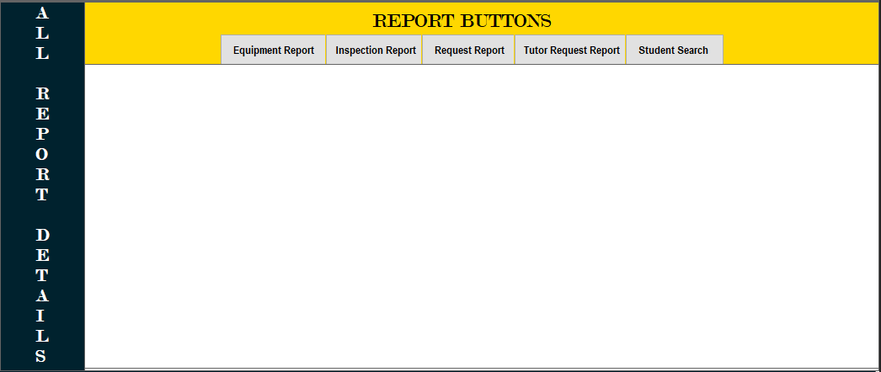
SYSTEM REPORTS

Slide 33
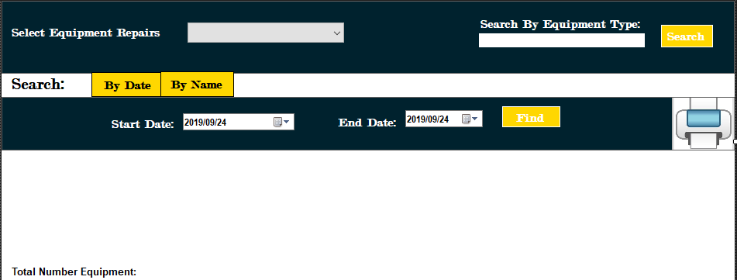
Reports Continues….
Equipment
Total number of equipment
Equipment that is broken
Equipment that is in for repairs
We use two button to search or show our controls for the report we want to display, we have search “By Date” and “By Name”.
Search:
By Date button makes the date controls be visible so as you going to use date to search equipment in between those dates selected.
By Name button makes the combobox and search button available to use. Whereby our combobox used to search for equipments that are broken or In for repair to see each total number of either way. In a search by equipment type we look for a total number of that certain types of equipments.

Slide 34
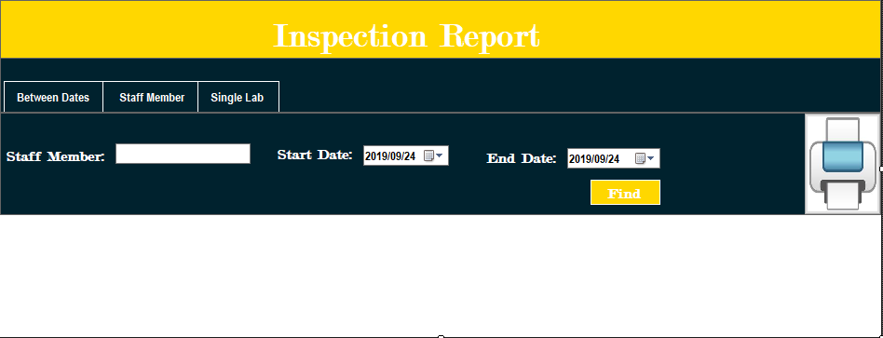
Reports Continues….
Inspection
Number of inspections between dates
Inspections for a staff member
Inspections in a single lab, in a month.
We also using three button to control all the necessary functionality of the report.
Between Dates used to search using dates
Staff Member button used if you want to search by a staff responsible for a inspection
Single LAB button used if you want to search by lab code by selecting on a combobox the venue a inspection has been taken.

Slide 35
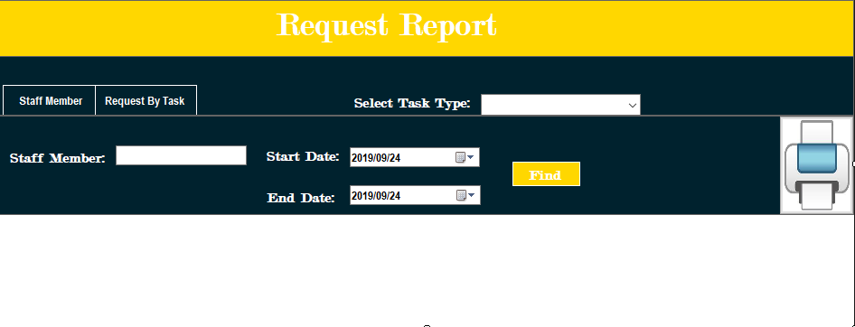
Reports Continues….
Requests
Request by task type.
Staff responsible for a request
Request for a month
Requests that end up at ICT Help Desk
We also using two button to control all the necessary functionality of the report.
Staff member used if you want to search by a staff responsible for a request, and search request for a month.
Request by task button used if you want to search by task by selecting on a combobox the task a request has been under.

Slide 36
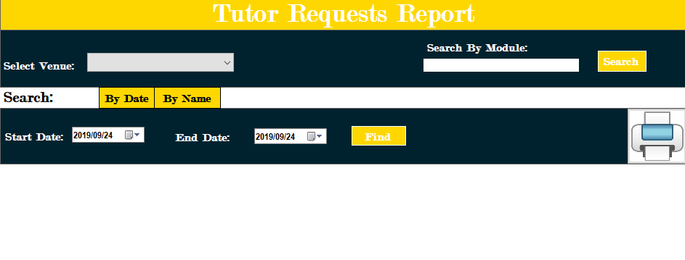
Reports Continues….
Tutor Requests
Tutor requests by module
Tutor requests in a venue
Tutor requests in a month

